Slide 1
CHAPTER 3
DERIVATIVES

Slide 2
CONTENTS
3.1. Derivatives
3.2. Derivative as a Function
3.3. Differentiation Formulae
3.4. Rates of Change in the Natural and Social Sciences
3.5. Derivatives of Trigonometric Functions
3.6. The Chain Rule
3.7. Implicit Differentiation
3.8. Derivatives of Logarithmic Functions
3.9. Related Rates
3.10. Linear Approximations and Differentials

Slide 3
3.4. RATES OF CHANGE IN THE NATURAL AND SOCIAL SCIENCES
3.4.1. Physics
3.4.2. Chemistry
3.4.3. Biology
3.4.4. Economics
3.4.5. Other Sciences

Slide 4
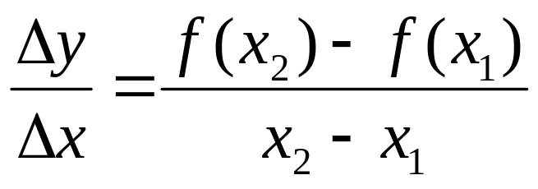
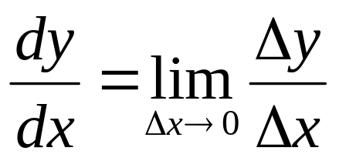
Recall that if y=f(x) and Δx = x₂ - x₁ is the change in x, Δy = f (x₂) - f (x₁) is the corresponding change in y, then the average rate of change of y with respect to x is
The instanteneous rate of change of y with respect to x is

Slide 5
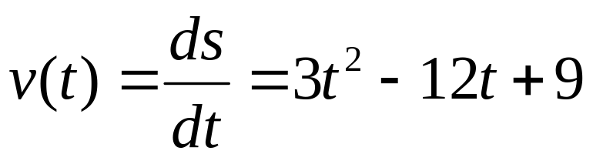
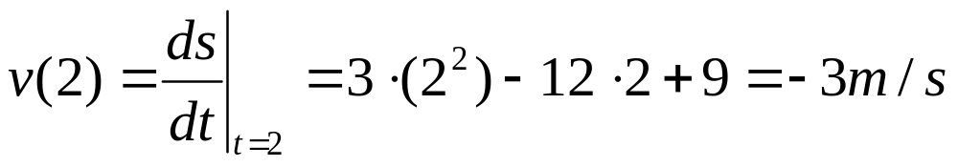
3.4.1 Physics
Example. The position of a particle is given (in meters) by s=f(t) =t³ - 6t² + 9t where t is measured in seconds.
(a) The velocity at time t is
(b) The velocity after 2 seconds is
The speed after 2 seconds is

Slide 6
(c) When is the particle at rest ?
Solution. the particle is at rest when v(t) = 0, hence
3t² - 12 t + 9 = 3(t –1)(t – 3) = 0
i.e. t = 1 or t = 3
(d) When is the particle moving forward ?
Solution. the particle is moving forward when v(t)> 0, hence
3t² - 12 t + 9 = 3(t –1)(t – 3) > 0
i.e. t < 1 or t > 3
It is moving backward when 1 < t < 3

Slide 7
(e) Draw a diagram to represent the motion of the particle
t = 3 s = 0
s
t = 0 s = 0
t = 1 s = 4

Slide 8
(f) The distance traveled in the first 5 seconds
Solution.
The distance traveled in the first second
f(1) - f(0)⎮= ⎮4 – 0⎮= 4m
The distance traveled from t = 1 to t = 3
f(3) - f(1)⎮= ⎮0 – 4⎮= 4m
The distance traveled from t = 3 to t = 5
f(5) - f(3)⎮= ⎮20 – 0⎮= 20m
The total distance traveled from t = 0 to t = 5
4 + 4 + 20= 28m

Slide 9
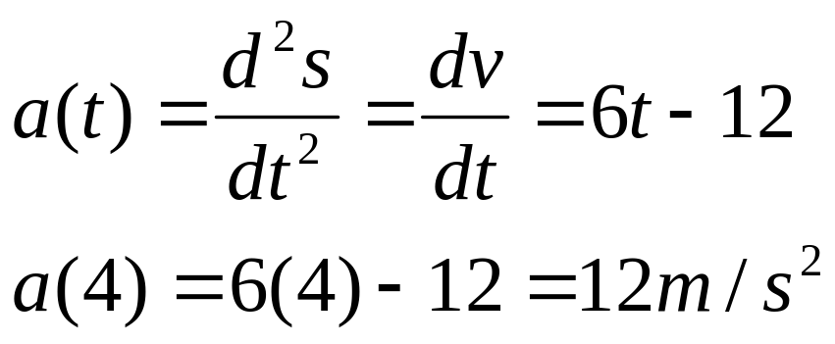
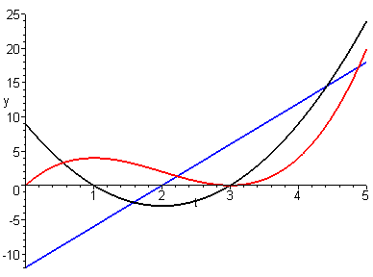
(g) The acceleration at time t and after 4 seconds
(h) The graphs of s, v, a

Slide 10
(i) When is the particle speeding up? When is it slowing down?
Solution. the particle is speeding up when v and a have the same sign, i.e. when 1 < t < 2 or t > 3
the particle is slowing down when v and a have opposite signs, i.e. when 0 ≤ t < 1 or 2 < t < 3

Slide 11
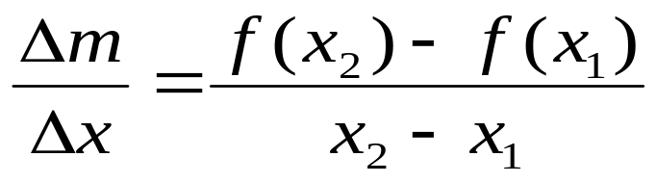
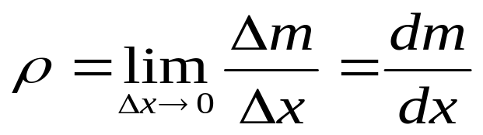
Example. Let m=f(x) be the mass of the left most part of length x of a non-homogeneous rod, then
the average density of the part between x₁ and x₂ is
The linear density ρ is the rate of change of mass with respect to length
x
m=f(x)

Slide 12
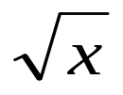
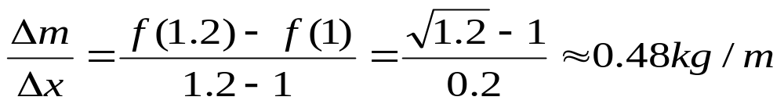
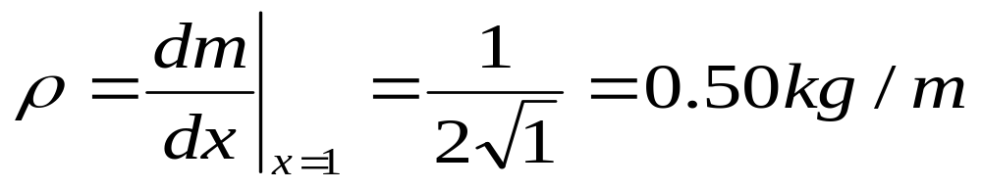
Let m=f(x)= be measured in kg and x in meters, then the average density of the part between 1 and 1.2 is
The linear density ρ at x=1 is

Slide 13
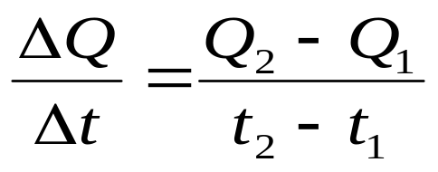
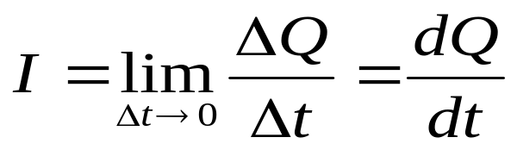
Example. Let ΔQ be the net charge passing through a section S of a wire during a time period Δt, then the average current during this time period is
The current I at a given time t is the rate of flow of charge through the section S
If Q is measured in coulomb and t in seconds then I is measured in amperes

Slide 14
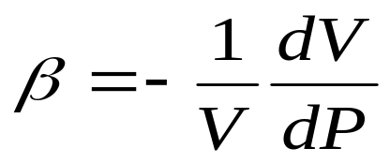
3.4.2 Chemistry
In thermodynamics, the volume V of a substance kept at a constant temperature depends on the pressure P. As P increases, V decreases so the derivative of V with respect to P is negative.
The isothermal compressibility measures how fast, per unit volume, the volumes decreases as the pressure increases at constant temperature. It is defined by

Slide 15
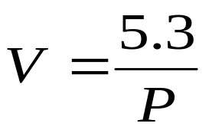
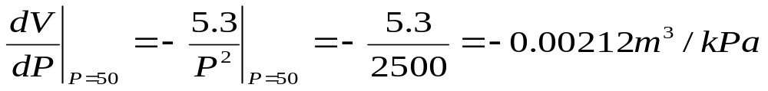
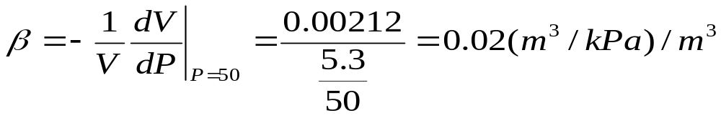
Example. The volume (in m³) of a sample air at 25º C under the presure P (kilopascals) is given by
The rate of change of V w.r.t. P at P = 50 kPa is
The compressibility at that pressure is

Slide 16
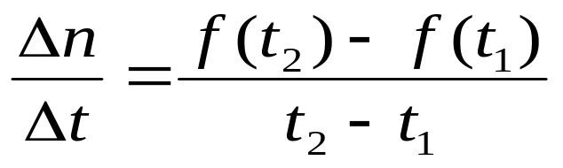
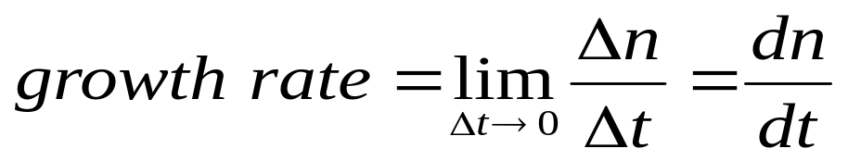
3.4.3 Biology
Example. Let n=f(t) be the number of individuals in a population, then the average rate of growth during the period t₁ ≤ t ≤ t₂ is
The instantaneous rate of growth at time t is

Slide 17
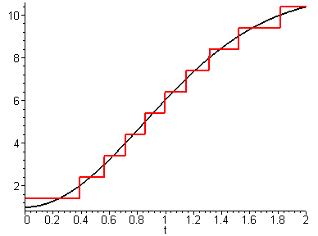
Remark. The function n=f(t) is discontinuous at several points and hence non-differentiable there. However we can approximate it by a smooth function

Slide 18
Example. A population of bacteria is initially of size n₀ and double every hour, then
f(1) = 2 f(0) = 2 n₀
f(2) = 2 f(1) = 2² n₀
f(3) = 2 f(2) = 2³ n₀
………………………………
We can approximate it by the exponential function
f(t) = 2^{t} n₀

Slide 19
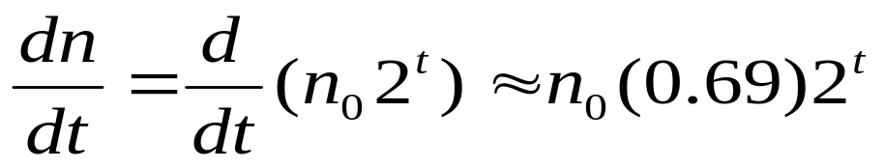
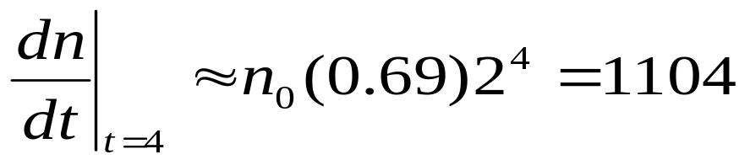
The rate of growth of the population at time t is
With n₀ = 100, then the rate of growth after 4 hours is

Slide 20
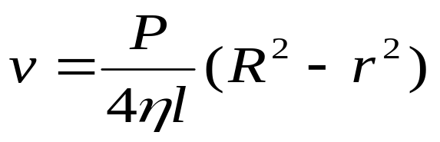

Example. The flow of blood in a cylindrical blood vessel of radius R and length l follows the Law of laminar flow
Where v is the velocity of blood at the distance r from the axis of the tube, η the viscosity of the blood and P the difference of pressure between two ends of the tube.
_{R}
_{l}

Slide 21
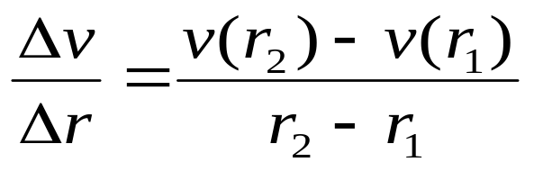
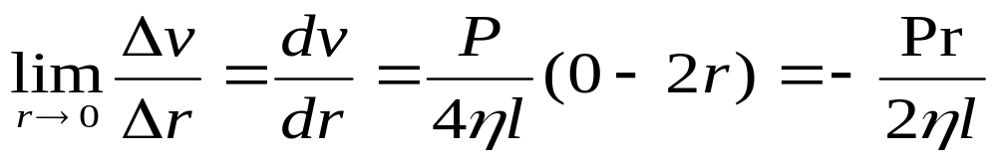
The average rate of change of the velocity as we move outward from r₁ to r₂ is
The instantaneous rate of change of the velocity with respect to r is

Slide 22
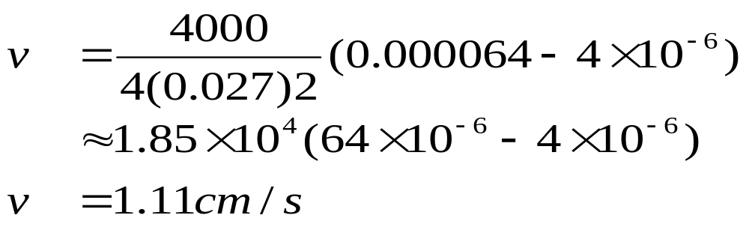
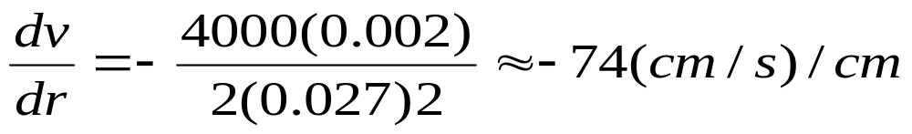
For small human arteries, η = 0.027, R=0.008cm, l=2cm, and P=4000dynes/cm². So the speed at r = 0.002cm is
The velocity gradient at that point is

Slide 23
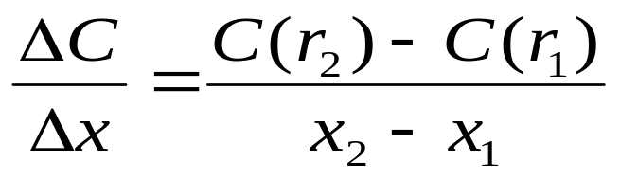
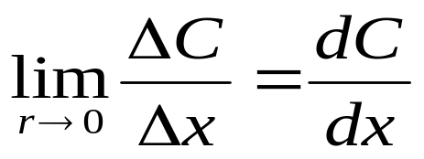
3.4.4 Economics
Example. The cost function C(x) is the cost of producing x units of a commodity. The average rate of change of the cost from x₁ to x₂ is
The instantaneous rate of change of the production cost with respect to the number of items produced (the marginal cost) is

Slide 24
Taking Δx = 1, x = n large we may approximate C' by
C’ ≈ C(n+1) - C(n)
Suppose a company estimate the cost of producing x items as
C(x) = a + bx + cx²
where a = 10,000 is the overhead cost, b = 5 is the material cost, c = 0.01 is the labor cost
The marginal cost function is
C’(x) = 5 + 0.02x

Slide 25
The marginal cost at the production level of 500 items is
C’(500) = 5 + 0.02(500) = $15/item
This is also the predicted cost of producing the 501st item.
The actual cost of producing the 501st item is
C(501)-C(500)=[10,000+5(501)+0.01(501)²] - [10,000+5(500)+0.01(500)²]=$15.01/item
Notice that
C’(500) ≈ C(501)-C(500)

Slide 26
3.4.5 Other Sciences
Geologists interest in the rate of heat flow
Psychologists interest in the rate of improvement of performance
Sociologists interest in the rate of spread of a rumor
All of these are based on the mathematical concept of derivative

